Slide 1




Trust Bank – Lending Modernization
MKT 6364.501 S’25 – BY “AI TRESPASSERS”
Priyadarshan Parida
Sunayana Jana
Silvia Rojas Menjivar
Vaishnavi Suresh Iyer

Slide 2



Company Background & Problem Statement
Trust Bank has seen a 3x surge in loan applications due to the closure of a competitor bank.
Manual assessment of creditworthiness is slow and inefficient, causing potential revenue loss and customer dissatisfaction.
Seeks to explore AI-driven approach to assess creditworthiness quickly and accurately.
BACKGROUND
Small-scale community bank with limited technology infrastructure. Focused on relationship-based lending.
Traditionally, creditworthiness assessed by manual deliberation of the applicant’s financial standing.
V
VALUE: AI-driven credit assessment improves efficiency, reduces risk, and enhances customer experience.
STRENGTH
Established customer trust and local market expertise.
WEAKNESS
Manual, slow loan approval process, limited tech adoption, higher operational costs for scaling.
R
RARITY: Few community banks leverage AI in lending, creating a competitive edge.
OPPORTUNITY
Increased customer base from competitor’s closure, AI-driven
decisioning.
THREAT
Lost prospects to the competitors.
I
INIMITABLE: Machine learning models built on proprietary data can provide unique insights.
O
ORGANIZED: Requires investment in digital infrastructure, change management, and upskilling staff.

Slide 3
The Business Case for AI in Creditworthiness
15% of net revenue in provisions for loan losses at the community banks (S&P Global).
Digital-first lenders leveraging AI are gaining market share, while many community banks anticipate declining credit quality in key lending areas (CSBS).
Underwriting inefficiencies caused by manual credit evaluation slow approvals, increase operational costs, and limit scalability (Dallas Fed).
Friction in Experience
AI in
Lending
Leading & Lagging Indicators
Slow and offline loan approvals can create friction in customer experience, which will, in turn, lead to high dropout rates.
Predictive analytics improves accuracy by assessing vast amounts of historical data and Automates risk assessment, eliminating manual touchpoints.
A typical KPI in AI-based data-driven decisions is conversion rate. This is considered a leading indicator resulting in higher revenue, which is a lagging indicator.
Notes:
1. Limited Data or Unique Local Context
2. Tailored Lending Policies
3. Risk Mitigation
4. Customization of Loans
5. Credit Score Gaps

Slide 4








Lending Decisions at Trust Bank - The Current Landscape
Loan Origination
Loan Processing
Underwriting
Decisioning
Closing, Disbursement, Servicing
Approval
Customer
Bank
Loan Officer
Loan Officer / Underwriter
Sr. Underwriter
Customers apply for a loan through in-person visits, phone, or email.
The loan officer ensures the completeness of the application.
The loan officer performs a manual credit risk assessment based on the customer's financial standing.
The underwriter reviews all the documents, including the credit risk assessed in the previous step.
Disapproval
Friction points in the customer experience.
Part of the workflow that’s in scope in the current phase of engagement.
Average end-to-end lending decisions can take 1-2 weeks (excluding the closing and disbursement). The red dots highlight the areas with higher manual touchpoints that likely cause friction in customer experience.
Higher loan application volume can further exacerbate the problem. The current engagement scope only focusses on the part of the underwriting process that assesses credit risk (highlighted in dotted RED line)

Slide 5

Proposed Solution: AI - Based Credit Risk Assessment
Loan Origination
Loan Processing
Underwriting
Decisioning
Closing, Disbursement, Servicing
Approval
Customer
Bank
Loan Officer
AI System
Sr. Underwriter
Customers apply for a loan through in-person visits, phone, or email.
The loan officer ensures the completeness of the application.
Manual credit risk assessment is replaced by a Machine Learning data-driven solution.
The underwriter reviews all the documents, including the credit risk assessed in the previous step.
Disapproval
Friction points in the customer experience.
Part of the workflow that’s in scope in the current phase of engagement.
With the AI-based data-driven credit risk assessment, the average end-to-end lending decision timeline can reach 3-5 business days, i.e., down 50%.
This timely improvement can substantially alleviate the congestion caused by the surge in the inflow of loan applications.

Slide 6

Proposed Target State: Digital Lending with AI
Loan Origination
E-2-e Lending Decision
Review / Override (Optional)
Closing, Disbursement, Servicing
Approval
Customer
Front-end Application Plus AI System
Underwriter
Customers apply for a loan through the digital channels.
This is an optional step where the underwriter reviews/overrides based on the threshold for metrics.
Disapproval
The proposed target state is a digital lending application that can process loan applications end-to-end. This can provide lending decisions to the customer in real-time or near real-time.
The solution is highly scalable but does require significant upfront investment. However, the ROI is promising.

Slide 7









Proposed Solution: Technical Approach
Data Ingestion & Storage
Data Pre-processing, Feature Engineering & EDA
Model Development & Validation
Model Testing
Model Deployment & Integration
Monitoring and Reinforcement
Out of scope for the current phase of engagement.
The historical data available for this implementation has data on customers’ financial standing mapped to the creditworthiness which makes this a Supervised Learning – classification problem.
Multiple classification algorithms will be compared to determine the winner. Class imbalance and overfitting problems will be carefully handled.

Slide 8
Recommendations & Next Steps - The “ELEVATE” Framework
E – Establish Value-Driven Transformation
Align AI adoption with business goals, improving speed, cost efficiency, and customer experience.
E
L – Launch Tactical AI Fix (PHASE 1)
Implement a quick, AI-driven credit risk assessment to address immediate bottlenecks.
L
E – Embrace Digitization & Digitalization
Convert analog data infrastructure into digital format and adopt digital technologies to enhance or transform business processes.
E
V – Vitalize Workforce with Upskilling & Change Management
Ensure smooth AI adoption by training employees and driving organizational readiness.
V
A – Advance for Digital Lending - A Strategic Change (PHASE 2)
Navigate formal institutions by adhering to regulations and mitigating risks, and the informal institutions by aligning with public expectations.
A
T – Transition to Cloud & SaaS-Based Lending (PHASE 3)
Enable long-term scalability and agility by leveraging cloud-based solutions.
T
E – Ensure Compliance, Ethical AI, and Evolve Continuously
Address regulatory requirements and prioritize responsible AI. Establish a roadmap for iterative improvements and future AI innovations.
E

Slide 9
ROI Considerations
Considerations for the expected return on investment are categorized as Financial, Operational, and Customer-centric.
Faster and Accurate Processing
Improved Efficiency & Lower Cost
Increased revenue
Although the proposed target-state architecture requires a significant upfront investment, the ROI outlook is promising.
Lower Credit Losses & Loan Defaults
Customer Satisfaction & Engagement

Slide 10
Challenges
1
Compliance with fair lending laws (e.g., Equal Credit Opportunity Act, Fair Housing Act) and data privacy laws.
Ethical Considerations
Addressing biases, data privacy, and the responsible use of AI to ensure fair and accountable credit decision-making.
2
Risk of AI bias and discrimination leading to regulatory scrutiny.
3
Need for explainability and transparency in AI-driven decisions.
1
Ensuring fair and unbiased credit assessments across all demographics.
2
Ensuring borrowers understand how their data is used and decisions are made in the lending process.
Regulatory Concerns
Compliance with legal and financial regulations to ensure AI-driven lending decisions are fair, transparent, and non-discriminatory.
3
Balancing automation with human oversight to maintain trust and address perceived unfairness.

Slide 11
Thank you!

Slide 12
References
https://www.spglobal.com/market-intelligence/en/news-insights/research/community-bank-earnings-will-recover-despite-weaker-credit-sticky-deposit-costs
https://www.csbs.org/node/510346
https://www.dallasfed.org/research/swe/2024/swe2418
https://www.universalclass.com/articles/business/finance/loan-processing-step-by-step.htm
https://www.communitybankingconnections.org/articles/2015/q1/development-and-maintenance-of-an-effective-loan-policy
https://www.kaggle.com/datasets/thuranaing411/creditworthiness?select=customers-to-score.xlsx

Slide 13
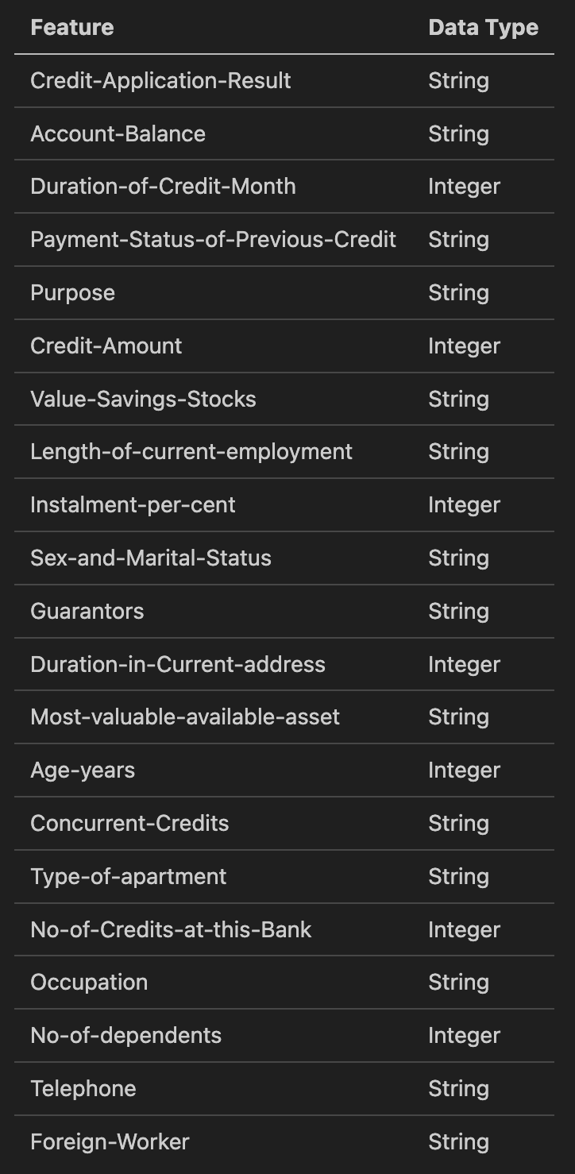
Feature Set

